Slide 1
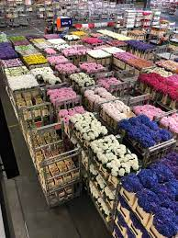
C++ Workshop Series for UoM Flower Exchange – Group Project

Slide 2
Flower Exchange Group Project
Two persons per group
Duration - Three weeks
This is the only Assessment for this workshop
*Date of completion – 13th June 2023
*Demonstration of the project – 16th June 2023 at LSEG Technology Malabe
*Exact dates to be decided by the university

Slide 3
Flower Exchange Story
The flower exchange is a system which supports basic trading.
Trader Application - Traders can submit buy or sell orders for flowers via the Trader Application.
Exchange Application - will process the incoming order against existing orders in the order container(known as Order Book) and do a full or partial execution.
Every order is replied with an Execution Report by the Exchange Application indicating the status of the order.
Orders sometimes could be rejected due to quantity limitations, invalid flower type, etc.

Slide 4
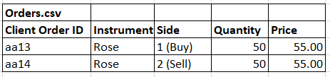
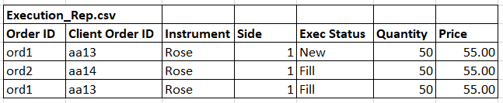
Flower Exchange – High Level Architecture
Trader Application
Exchange Application
orders.csv
Order(s)
Execution Report (s)
execution_rep.csv

Slide 5
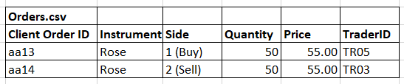
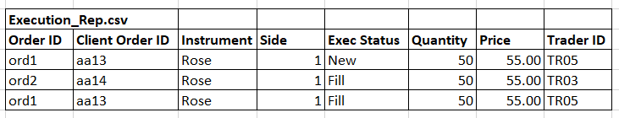
Flower Exchange – A simpler implementation (2nd option)
Exchange Application
orders.csv
execution_rep.csv
Basically, read an orders.csv fila and produce an execution_rep.csv file

Slide 6
Flower Exchange – Input order
Field Name | Type | Possible Values | Mandatory | Notes
Client Order ID | String | Alpha numeric string (max 7 chars) | Yes | This unique ID identifies the submitted order
Instrument | String | {Rose, Lavender, Lotus, Tulip, Orchid) | Yes | We will limit the instruments for these 5 types only
Side | Int | 1 : Buy ; 2 : Sell | Yes | Specifies if the input order is a buy order or a sell order
Price | double | Price > 0.0 | Yes | Price of one unit
Quantity | int | {10, 20, 30, …. , 1000} Order size must be a a multiple of 10. Min 10, Max 1000 | Yes | Quantity of the order

Slide 7
Flower Exchange – Output Execution Report
Field Name | Type | Possible Values | Mandatory | Notes
Client Order ID | String | Alpha numeric string (max 7 chars) | Yes | This is the Client Order ID of the submitted order
Order ID | String | Alpha numeric string | Yes | System generated unique order ID
Instrument | String | {Rose, Lavender, Lotus, Tulip, Orchid) | Yes | We will limit the instruments for these 5 types only
Side | Int | 1 : Buy ; 2 : Sell | Yes | Specifies if the order is a buy order or a sell order
Price | double | Price > 0.0 | Yes | Price of one unit
Quantity | int | {10, 20, 30, …. , 1000} Order size must be a a multiple of 10. Min 10, Max 1000 | Yes | Quantity of the order
Status | int | 0 – New 1 – Rejected 2 – Fill 3 - Pfill | Yes | The status of the execution report
Reason | String | Max 50 chars | No | Contains the reject reason, when an order is not accepted into the system due to validation failure
Transaction Time | String | YYYYMMDD-HHMMSS.sss | Yes | Every execution report should have the transaction time in the given format. This data can be used to check the speed and optimize your code

Slide 8


Order book – Example 1
Exchange app maintains one order book for each Instrument (flower type). Since there are 5 types of Instruments, there will be five separate order books in our system.
Orderbook has two sides. Buy (blue), Sell (pink)
Initially the orderbook is empty
The order book receives an order. (Side = Sell, Price = 55.00, Qty = 100)
This order will go inside sell side of the order book, and an execution report with status “New” will be disseminated
Side = 1 : Buy Side
Side = 2 : Sell Side
Orderbook : Rose (Initially empty)
Order ID | Qty | Price | Price | Qty | Order ID
100 @ 55.00
Exchange App
Orderbook : Rose – (After the 100 @ 55.00 order enters the book)
Order ID | Qty | Price | Price | Qty | Order ID
 |  |  | 55.00 | 100 | ord1

Slide 9
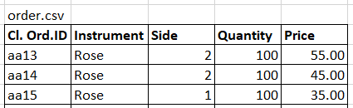
Order Book - Example 2
1. Sell 100 @ 55.00
3. Buy 100 @ 35.00
Orderbook : Rose (Initial state)
Order ID | Qty | Price | Price | Qty | Order ID
State – 2
Order ID | Qty | Price | Price | Qty | Order ID
 |  |  | 45.00 | 100 | ord2
 |  |  | 55.00 | 100 | ord1
2. Sell 100 @ 45.00
State - 1
Order ID | Qty | Price | Price | Qty | Order ID
 |  |  | 55.00 | 100 | ord1
State – Final
Order ID | Qty | Price | Price | Qty | Order ID
ord3 | 100 | 35.00 | 45.00 | 100 | ord2
 |  |  | 55.00 | 100 | ord1

Slide 10
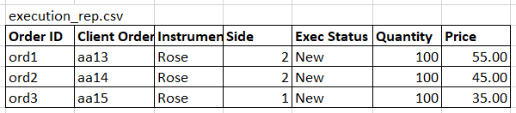
Order Book - Example 2
Exchange App

Slide 11
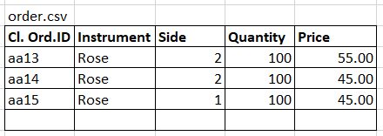
Order Book - Example 3 (A FILL execution)
Aggressive order (an incoming order which executes)
Passive order (an incoming order which goes into the OB without exeucuting)
1. Sell 100 @ 55.00
3. Buy 100 @ 45.00
Orderbook : Rose (Initial state)
Order ID | Qty | Price | Price | Qty | Order ID
State – 2
Order ID | Qty | Price | Price | Qty | Order ID
 |  |  | 45.00 | 100 | ord2
 |  |  | 55.00 | 100 | ord1
2. Sell 100 @ 45.00
State - 1
Order ID | Qty | Price | Price | Qty | Order ID
 |  |  | 55.00 | 100 | ord1
State – Final
Order ID | Qty | Price | Price | Qty | Order ID
 |  |  | 55.00 | 100 | ord1

Slide 12
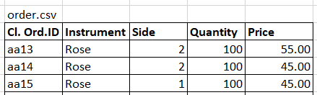
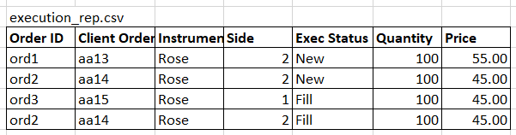
Order Book - Example 3
Exchange App

Slide 13
Order book
Buy side of the orderbook is sorted in the ascending order of the price. (Higher the buy price, more attractive the order)
Sell side of the orderbook is sorted in the descending order of the price. (Lower the sell price, more attractive the order)
Orders with the same price are ordered in the time priority. (Priority sequence)
Orderbook : Rose | Orderbook : Rose
Pr.Seq | Order ID | Trader ID | Qty | Price | Price | Qty | Trader ID | Order ID | Pr.Seq
1 | ord4 | Tr04 | 100 | 4.00 | 5.00 | 200 | Tr02 | ord2 | 1
1 | ord8 | Tr08 | 200 | 3.00 | 5.00 | 100 | Tr03 | ord3 | 2
2 | ord7 | Tr02 | 200 | 3.00 | 6.00 | 100 | Tr01 | ord1 | 1

Slide 14
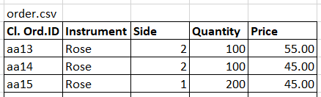
Order Book - Example 4 (A PFILL execution)
1. Sell 100 @ 55.00
3. Buy 200 @ 45.00
Orderbook : Rose (Initial state)
Order ID | Qty | Price | Price | Qty | Order ID
State – 2
Order ID | Qty | Price | Price | Qty | Order ID
 |  |  | 45.00 | 100 | ord2
 |  |  | 55.00 | 100 | ord1
2. Sell 100 @ 45.00
State - 1
Order ID | Qty | Price | Price | Qty | Order ID
 |  |  | 55.00 | 100 | ord1
State – Final
Order ID | Qty | Price | Price | Qty | Order ID
ord3 | 100 | 45.00 | 55.00 | 100 | ord1

Slide 15
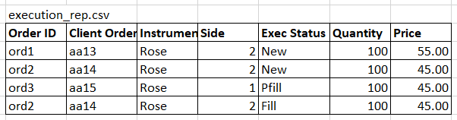
Order Book - Example 4
Exchange App

Slide 16
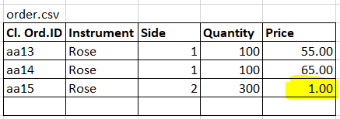
Order Book - Example 5 (A FILL execution with a twist)
The execution price of an aggressive order is decided by the orderbook
1. Buy 100 @ 55.00
3. Sell 300 @ 1.00
Orderbook : Rose (Initial state)
Order ID | Qty | Price | Price | Qty | Order ID
State – 2
Order ID | Qty | Price | Price | Qty | Order ID
ord2 | 100 | 65.00
ord1 | 100 | 55.00
2. Buy 100 @ 65.00
State - 1
Order ID | Qty | Price | Price | Qty | Order ID
ord1 | 100 | 55.00
State – Final
Order ID | Qty | Price | Price | Qty | Order ID
 |  |  | 1.00 | 100 | ord3

Slide 17
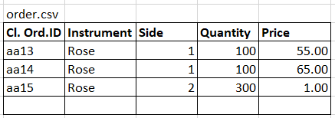
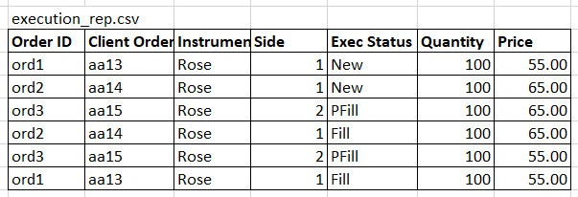
Order Book - Example 5
Exchange App

Slide 18
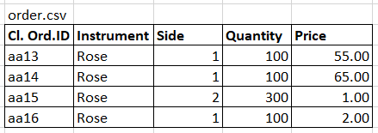
Order Book - Example 6
Buy 100 @ 55.00
Buy 100 @ 65.00
4. Buy 100 @ 2.00
Orderbook : Rose (Initial state)
Order ID | Qty | Price | Price | Qty | Order ID
State – State 3
Order ID | Qty | Price | Price | Qty | Order ID
 |  |  | 1.00 | 100 | ord3
3. Sell 300 @ 1.00
State – 2
Order ID | Qty | Price | Price | Qty | Order ID
ord2 | 100 | 65.00
ord1 | 100 | 55.00
Final state
Order ID | Qty | Price | Price | Qty | Order ID

Slide 19
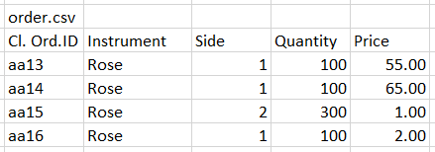
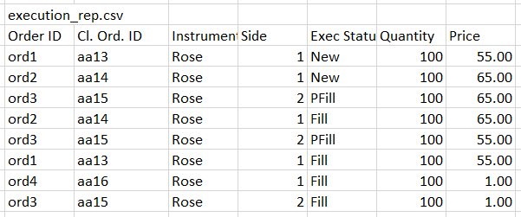
Order Book - Example 6
Exchange App

Slide 20
Flower Exchange – Input validations
An order will be rejected if
It does not contain a required field
It is for an invalid Instrument
It contains an invalid side
Its price is not greater than 0
Its quantity is not a multiple of 10
Its quantity is outside the range (min = 10 max = 1000)
A Rejected execution report is generated when validations are failed

Slide 21
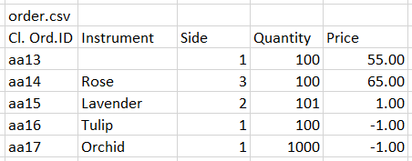
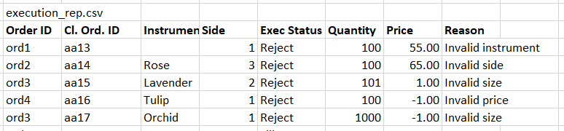
Order Book - Example 7 (Input Validations)
Exchange App
A validation failure results in a Rejected Execution Report

Slide 22
Flower Exchange – Verify your system
We have provided you 6 sample input files (order.csv) and corresponding sample output files (exec_rep.csv) files in the previous examples.
When developing your system, test your system with the sample input files we provided and verify your system produces the same output as in the sample execution_rep.csv files
SampleOrder1.csv (give this as an input to your app)
Exchange system
execReports1.csv (compare with the sample execution_rep.csv given in the slides)
Compare :
exeReports.csv generated by your system matches the sample execution_rep.csv – Pass
exeReports.csv generated by your system produces a different output to sample execution_rep.csv – Fix your bugs, and re-test
Note that the order of the execution reports in your file does not have to be the same as ours. But the content should be the same.

Slide 23
Flower Exchange – Evaluation
Demonstration and code review – You will demonstrate the system and we will do a code review with you.
Project will be evaluated for the design, coding practices, efficiency of the program and the speed of the program.
During the demo, we will test your application against our test data (orders.csv) and verify the functional accuracy.
To test the speed of the program we will input a large orders.csv and measure the time taken to produce the resulting exec_reports.csv (Note that Transaction Time is a mandatory field in the Execution Report)

